Slide 2
Reactive Programming
Session Code: DEV375
aka “Data Binding Gone Mad”
Paul Stovell MVP: Client Application Development
Senior Developer
Readify

Slide 3
Notes (hidden)
Some speakers at Microsoft like to use this slide for hidden “notes slides”.
Delete it if you don’t want to use it.
NEXT: <next slide title>

Slide 4
Presentation Outline (hidden slide):
Speaker instructions: Complete this slide to assist your SME (subject matter expert) in evaluating your presentation flow, topic coverage, demo integration and alignment of content to your session description and level.
Title: Reactive Programming
Technical Level: 300
Intended Audience: Rich client developers
Objectives (what do you want the audience to take away from this session):
1.Data Binding in Windows Forms/WPF is very powerful
2.Reactive programming can reduce code and make programs simpler
3.LINQ is very extensible
Presentation Outline (including demos):

Slide 5
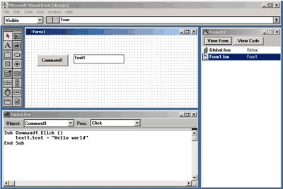
Visual Basic 1.0 for Windows
1991
Sub Command1_Click()
text1.text = "Hello world"
End Sub

Slide 6

Part I: Reactive Programming

Slide 7
Microsoft Excel
demo
Notes:
If you would like to host your demo on the Virtual Server, please use the myVPC demo slide, not this slide.

Slide 8
Discreet evaluation and assignment
a = b + c
Continuous
data flow

Slide 9
Propagating change
.NET 1.0
interface INotifyPropertyChanged
{
event PropertyChangedEventHandler PropertyChanged;
}
interface INotifyCollectionChanged
{
event NotifyCollectionChangedEventHandler CollectionChanged;
}

Slide 10
Using INotifyPropertyChanged
demo
Notes:
If you would like to host your demo on the Virtual Server, please use the myVPC demo slide, not this slide.

Slide 11
Manipulating the Flow
Format strings
Converters
Type Descriptors

Slide 12
WPF Converters
demo
Notes:
If you would like to host your demo on the Virtual Server, please use the myVPC demo slide, not this slide.

Slide 13
Type Descriptors
UI Control
Type Descriptor
Reflection
Contact

Slide 14
Type Descriptors
demo
Notes:
If you would like to host your demo on the Virtual Server, please use the myVPC demo slide, not this slide.

Slide 15
Part II: Reactive Domain Models

Slide 16
Model/View/ViewModel
Model
UI Control
View Model
Model
UI Control
View Model
Model

Slide 17
Reactive Applications
Service proxies, data access
User Interface
Bindable ViewModels
Models

Slide 18
Reactive Search
demo
Notes:
If you would like to host your demo on the Virtual Server, please use the myVPC demo slide, not this slide.

Slide 19
Part III: Bindable LINQ

Slide 20
Bindable LINQ
demo
Notes:
If you would like to host your demo on the Virtual Server, please use the myVPC demo slide, not this slide.

Slide 21
Alternatives
Bindable LINQ www.codeplex.com/bindablelinq
Obtics www.codeplex.com/Obtics
Continuous LINQ www.codeplex.com/clinq
Flapjax www.flapjax-lang.org

Slide 22
Summary
Propagation of changes to state
Try Bindable LINQ (or alternatives)
Forms should have no more than 200 lines of code

Slide 23
Visual Basic 1.0 for Windows
1991
Sub Command1_Click()
text1.text = "Hello world"
End Sub

Slide 24
Q & A

Slide 25




Resources
www.microsoft.com/teched
Tech·Talks Tech·Ed Bloggers
Live Simulcasts Virtual Labs
http://microsoft.com/technet
Evaluation licenses, pre-released products, and MORE!
http://microsoft.com/msdn
Developer’s Kit, Licenses, and MORE!

Slide 26
Related Content
Breakout Sessions
DEV 475 – F#: For the Love of Programming
Hands-on-Labs
WIN01-HOL: Using Data Binding in Windows Presentation Foundation 3.5

Slide 27
Track Resources
My Blog: www.paulstovell.com

Slide 28
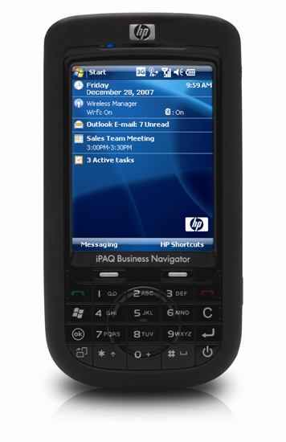


win!
Complete an evaluation on CommNet and enter to

Slide 29

© 2008 Microsoft Corporation. All rights reserved. Microsoft, Windows, Windows Vista and other product names are or may be registered trademarks and/or trademarks in the U.S. and/or other countries.
The information herein is for informational purposes only and represents the current view of Microsoft Corporation as of the date of this presentation. Because Microsoft must respond to changing market conditions, it should not be interpreted to be a commitment on the part of Microsoft, and Microsoft cannot guarantee the accuracy of any information provided after the date of this presentation. MICROSOFT MAKES NO WARRANTIES, EXPRESS, IMPLIED OR STATUTORY, AS TO THE INFORMATION IN THIS PRESENTATION.

